Slide 1
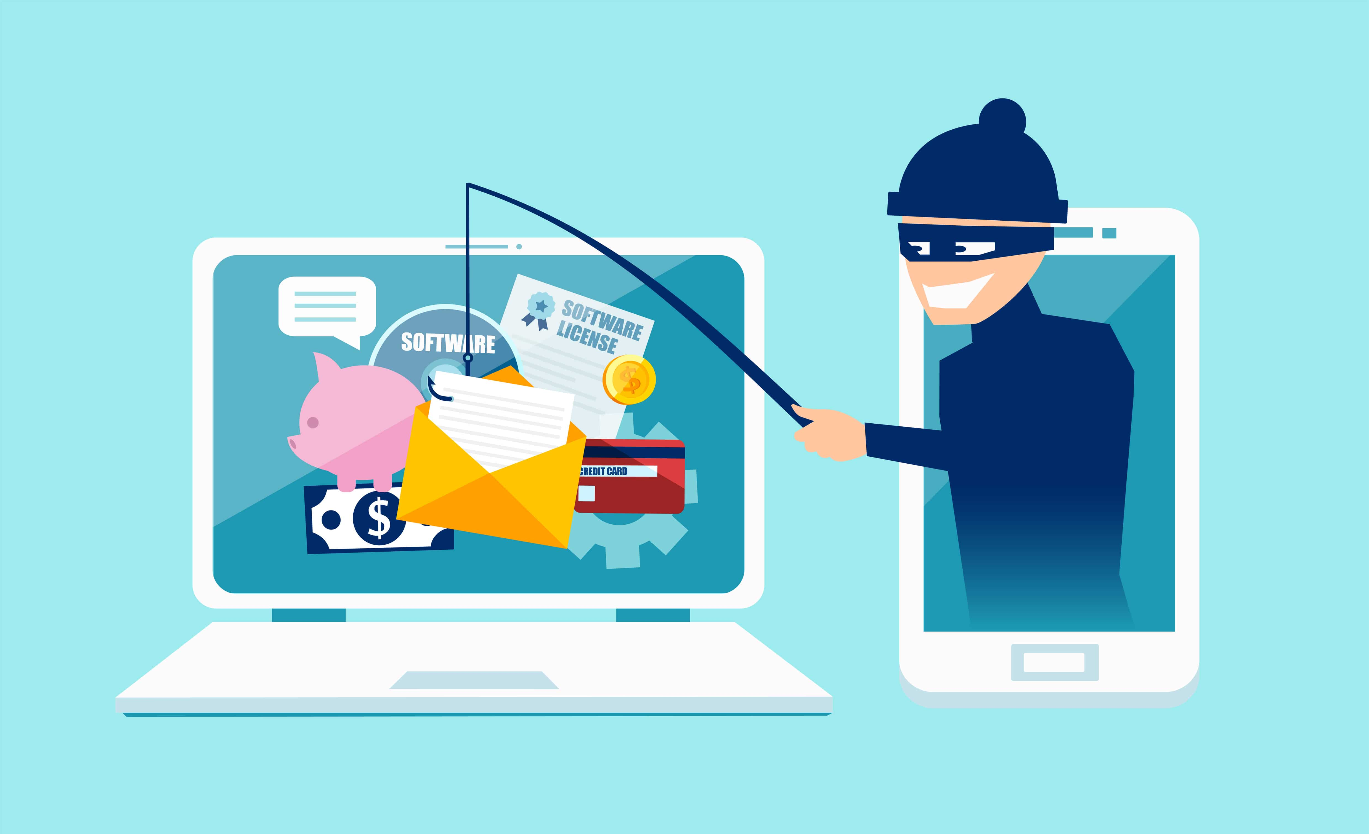
Phishing Facts
Be Aware and Do Not Take the Bait!

Slide 2
Importance of this Training
Cybercrime has become a powerful tool for stealing information. The anonymity and convenience of the internet has enabled criminals to launch highly targeted attacks with very little effort. The most successful and dangerous of all the cyber attacks is phishing. Security vendor research found over 94% of detected malware is delivered via email, which makes phishing the #1 cyber threat to organizations. With black market demand for information at an all-time high, Schuyler County is experiencing more phishing attacks. The attacks are becoming more sophisticated, targeted, and increasingly difficult to identify. The information in this training will increase your ability to identify a phish.

Slide 3
Content
• What is Phishing?
• Types of Phishing Attacks
• Results of Successful Phishing Attacks
• Tips for Identifying a Phish
• Phishing Email Examples
• Best Practices

Slide 4
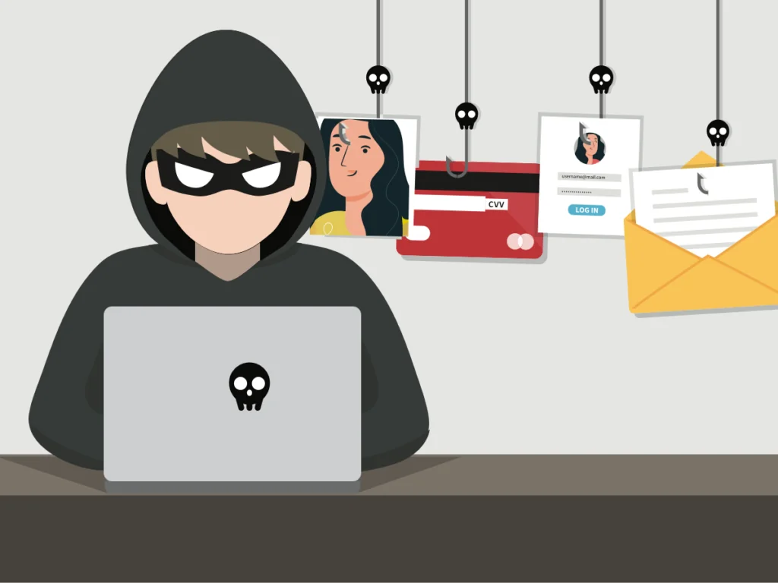
What is Phishing?
Phishing is an online scam where criminals send fraudulent email messages, appearing legitimate. The emails contain links or attachments that trick recipients into entering confidential information (e.g. account numbers, passwords) into fake websites, or they infect computers with malware.

Slide 5
Types of Phishing Attacks
Spear Phishing
Spear Phishing is a targeted attempt to steal sensitive information, typically focusing on a specific individual or organization. These types of attack use personalized facts in order to appear legitimate. Generally, cybercriminals turn to social media and company sites to research their victims.
Smishing
Smishing is a type of phishing that uses text (SMS) messages, as opposed to emails, to target victims. Fraudsters send a text message to an individual , usually calling for the individual to act.
Clone Phishing
In Clone Phishing, a legitimate and previously delivered email message is used to create an identical email with malicious content. The cloned email will appear to come from the original sender and will contain malicious links or attachments.
Vishing
Vishing is a phone scam, and has the most human interaction of all the phishing attacks. The fraudsters deceive victims by creating a sense of urgency to divulge sensitive information. Calls are often made through a spoofed ID, so it looks like a trustworthy source.
Whaling
A Whaling attack is an attempt to steal sensitive information from senior-level management. Whaling emails contain highly personalized information about the target or organization, so they are more difficult to detect.

Slide 6
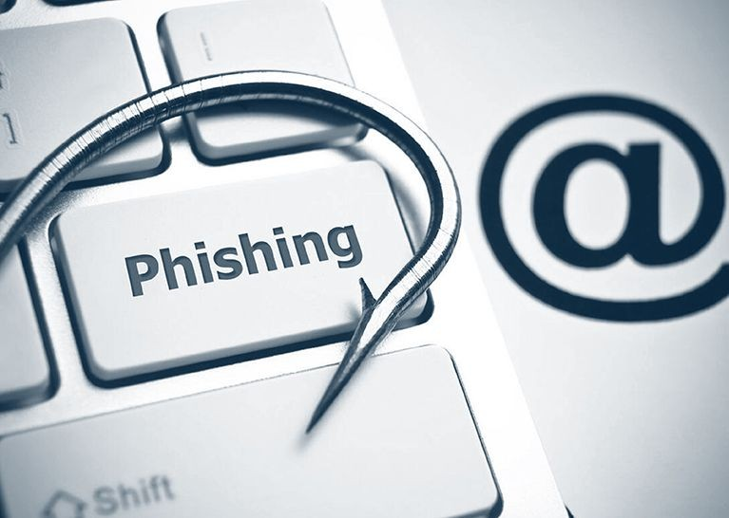
Successful Attacks Result in…
• Identity Theft
• Loss of Sensitive Information (personal or professional)
• Loss of Intellectual Property
• Data Sold to Criminals and Third Parties
• Financial Losses
• Unauthorized Transactions
• Exposed Usernames and Passwords
• Malware and Ransomware Installation
• Backdoors (access to systems) to Launch Future Attacks
• Reputational Damage

Slide 7
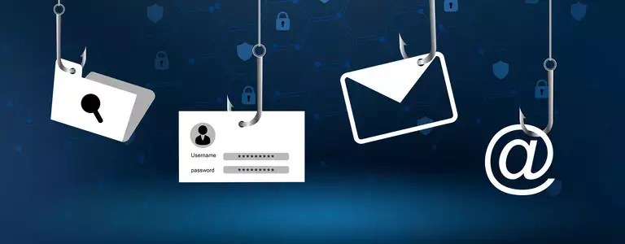
Tips for Identifying a Phish
Look for Messages with:
• Mismatched URLs
• Poor Grammar or Spelling
• Unexpected Correspondence/Unsolicited Requests
• Urgent or Threatening Language

Slide 8
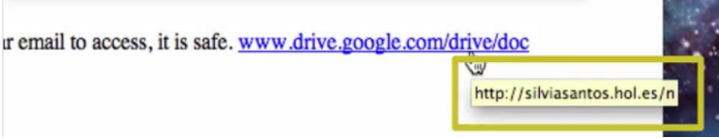
Mismatched URLs
Before clicking on any link, check the validity of the URL.
• Hover your cursor over the URL link—without clicking on it. The full hyperlinked address appears. If the URL does not match the address displayed, the message is most likely fraudulent
If you question the validity of the link,
• Call a known phone number (not one from the email) and ask about the message.
• Visit a trusted website (by manually typing the address in your browser).

Slide 9
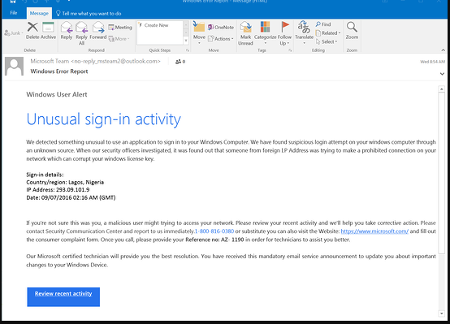
Poor Grammar and Spelling
Many phishing emails contain misspelled words and poor sentence structure. If you easily detected grammar-related errors in a message, it may be a phish.
In the email example to the left
• No individual word is misspelled, but the message is full of grammatical errors that a native speaker wouldn’t make, e.g., “We detected something unusual to use an application,” and a string of missed words, such as “a malicious user might trying to access.”
Look for obvious errors!
This is not to say an email with a mistake is a scam. Everyone makes typos from time to time.

Slide 10
Poor Grammar and Spelling (cont.)
Another strong indication of phishing scams is a misspelled or incorrect domain name.
Anyone can buy a domain name, and although every domain name must be unique, there are plenty of ways to create addresses that are similar to the domain being spoofed.
For example, a hacker bought the domain ‘gimletrnedia.com’ (that’s r-n-e-d-i-a, rather than m-e-d-i-a). The scam was so successful, it even tricked Gimlet Media’s CEO.

Slide 11

Unexpected Correspondence/ Unsolicited Requests
Reputable companies do not randomly send emails asking for personal information—such as account numbers, passwords, or pins—nor will reputable companies try to invoke some type of urgency to receive an immediate reply.
If you receive an email
• informing you that you have won a competition that you did not enter, or
• requesting that you click on a link to receive website content you did not request,
It is highly likely a phishing email.

Slide 12
Urgent or Threatening Language
A common phishing tactic is to promote a sense of fear or urgency, pressuring the recipient to quickly click on a link.
Cybercriminals will often use threats that your security or privacy is compromised and that urgent action is required to remedy the situation.
Therefore, be cautious of subject lines that claim “Unauthorized login attempt” or “Your account has been suspended.”
If you are unsure if the request is legitimate, contact the company directly via its official website or official telephone number.
Scammers will use common services, such as PayPal and Netflix, in a phish because individuals do not like problems with accounts could cause immediate inconveniences.
A sense of urgency is equally effective in workplace scams. Criminals know that most of us will drop everything if a boss emails us with a request, especially when other business processes are supposedly waiting on you.

Slide 13
Best Practices
• Top Tip: Look at the email address, not just the sender
• Ensure the message is not sent from a public email domain; no legitimate organization will contact you from an address that ends ‘@gmail.com’, not even Google. Legitimate emails from Google will read ‘@google.com’.
• If the domain name (after the @ symbol) matches the apparent sender of the email, the message is more likely to be legitimate.
• Never click on suspicious links or attachments, especially from unsolicited messages
• Go to the source if you have questions about the validity of the URL or message • Check the website security
• Ensure there is a padlock symbol in the URL address bar OR • Ensure the URL begins with https:// or shttp://. The added “s” indicates that the data will encrypted in transit.
• Create strong passwords on all accounts
• Educate your coworkers and family members, Others’ actions can result in a compromise of your data as well
• Be careful with online posts; do not give away too much personal information
• The more information criminals can gather on social media, the more targeted their attacks will become
• Enforce privacy options and restrict access to your social media accounts
• If the message claims to be internal, check for the absence of the .co.Schuyler.ny.us [EXT] and warning tags in the email message

